Slide 1

Rental System
UNDER THE GUIDENCE OF
Mr. Vijay Ramarao.
Presented by
P.Tulasi(06G71A0507).
D. K.S.Ratan(06G71A0520).
J.Veerendra nath(06G71A0585).

Slide 2

Contents
Abstract.
Scope of the Project.
Existing System.
Proposed System.
Requirements.
Modules.
Database.
UML Diagrams.
Conclusion.

Slide 3
Abstract
By this project instead of providing products from only one rental show room it provide all products as well information at one place, this application acting as interface between user and the rental showroom owners. Thus any rental showroom owners can display their products in our portal by simply register in our site by providing personal information without any restriction. This application provide some additional features to vendor to modify the products.

Slide 4
Scope Of Project
The purpose of this project is to transport the goods from source to destination in an effective and efficient manner. Rental hub is one stop rental portal. It provides services such as hiring cars,Apartment,Guest houses,Meeting&Conference halls and Computers. It provides the facility to make online orders and get everything done before you reach destination.

Slide 5
Existing System
In this case there are many rental systems which are available through online. But they are not providing all products at one place. For example car rental system in online deals only with cars.
Hence many of the rental systems are restricted to only one city.
Also present rental systems restricted to only one vendor, means products only from one rental show room.

Slide 6
Proposed System
The proposed system is web based system which can be accessed by customer from anywhere around the world.
The system can offer more number products from vendor in different locations.
The vendor can pay his amount for advertising his own rental product through submitting the credit card number.
This system accepts an online request from customers to reserve any rental system product for his own purpose.
Administrator plays a main role thus he can able to communicate the reservation information of any product to that particular vendor.

Slide 7
Software Requirements
Operating System: Windows XP or later
Database: Microsoft SQL Server-2005
Browser: Microsoft Internet Explorer
Tools: Microsoft Visual Studio .Net-2008
Technologies: ASP. Net with C#.Net

Slide 8
Hardware Specification
Processor: Intel Pentium or More
Ram: 512 MB Ram
Hard Disk: PC with 20GB

Slide 9
Modules
Registration
Advertise product
Data base maintenance
Searching and Booking the product
Verify Bookings and Intimate to Vendor
Authentication

Slide 10
Registration
This module is part of the vendor. Thus Vendor is
Rental showroom owner who advertises his property in
our web site.
The Vendor fills the registration form by giving the
personal information and successfully registers with the
website.
The personal information such as vendors name, Mobile
number,Address,Location of showroom ..est..

Slide 11
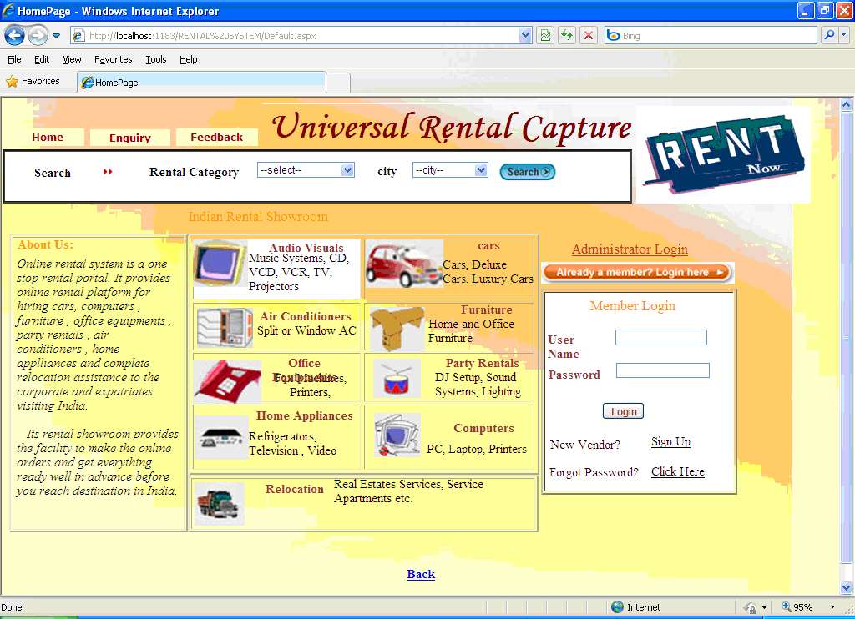
HOME PAGE

Slide 12
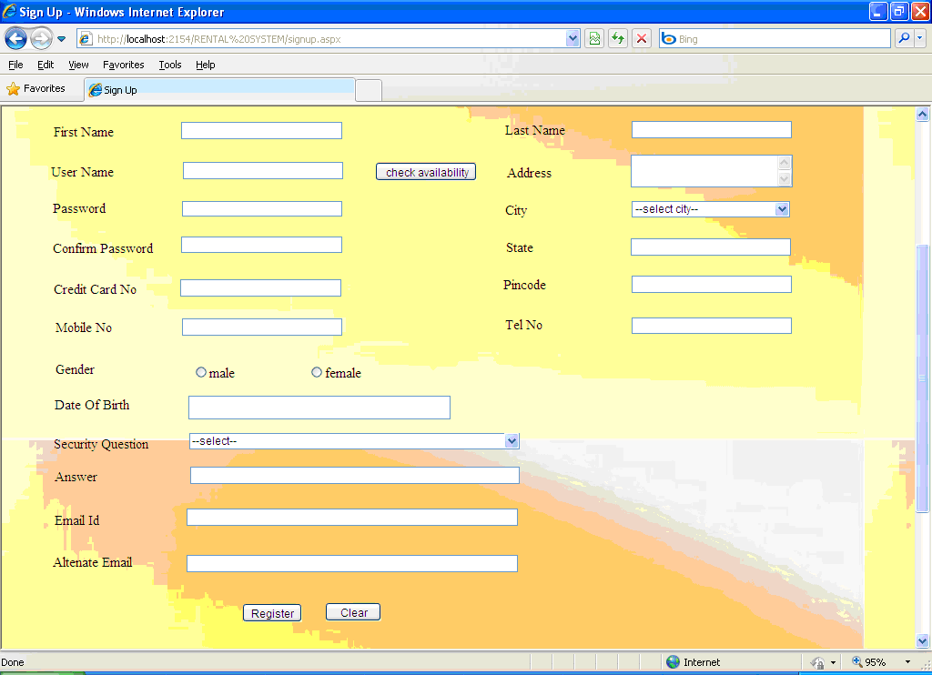

Slide 13
Advertise Products
After entering into vendor’s homepage vendor will
advertise his products by filling add product form by
providing sufficient details about product such as product
id, available dates, rent etc and upload the image of that
product.
It consists of following sub modules:
1. Update Product
2. Delete Product

Slide 14
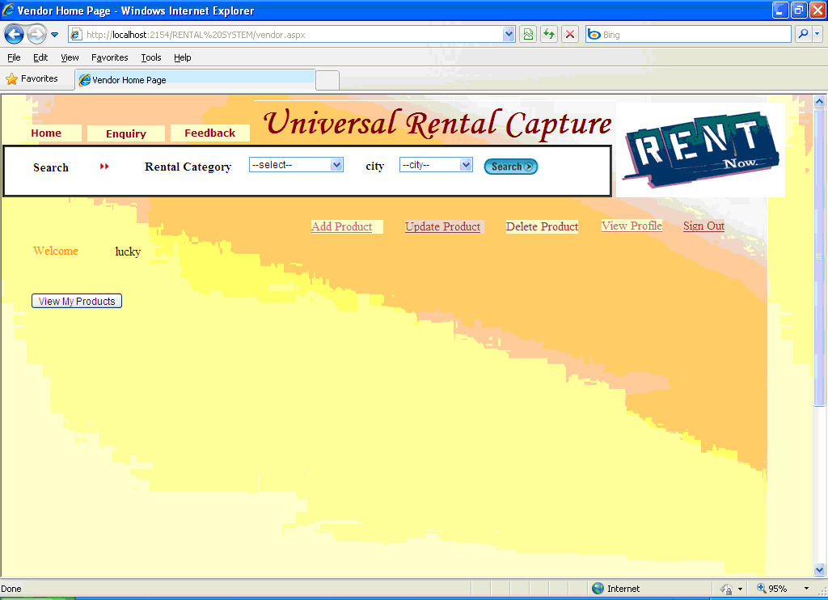
Vendor Home Page

Slide 15
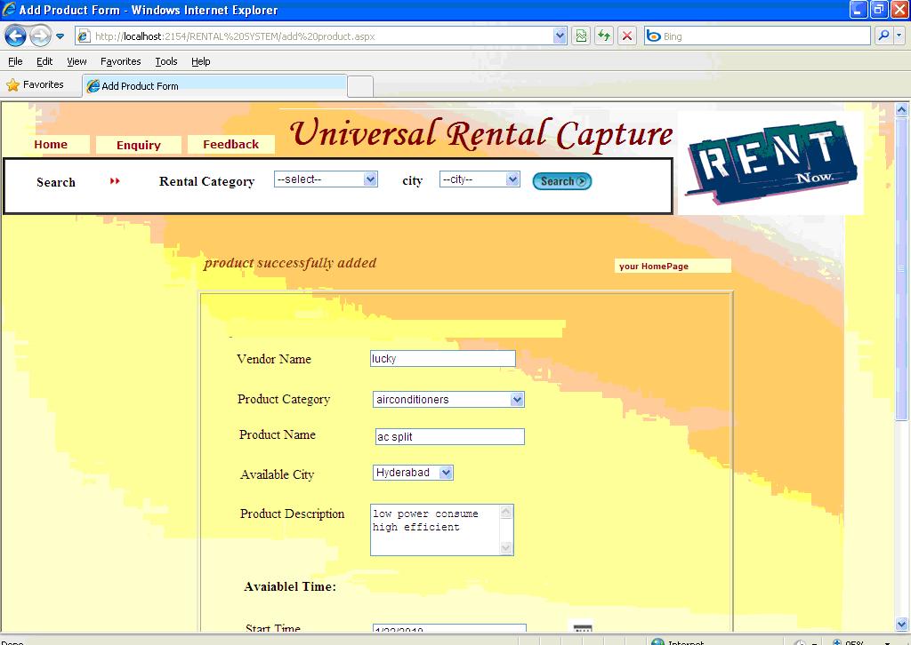
Add New Product

Slide 16
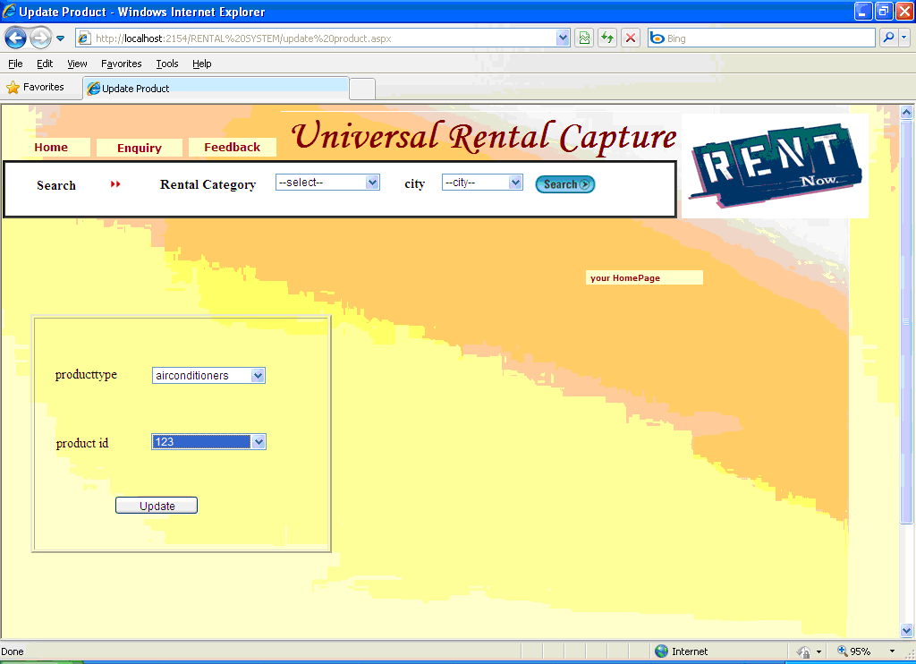
Vendor Update Product

Slide 17
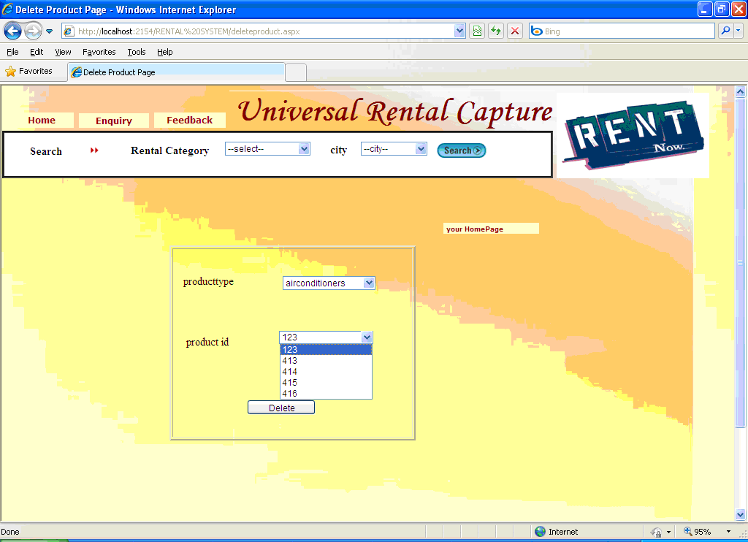
Vendor Delete Product

Slide 18

    The Customer after accessing the site he searches for products, if he finds the required product then he need to fill the booking form and submit to the database.

Slide 19
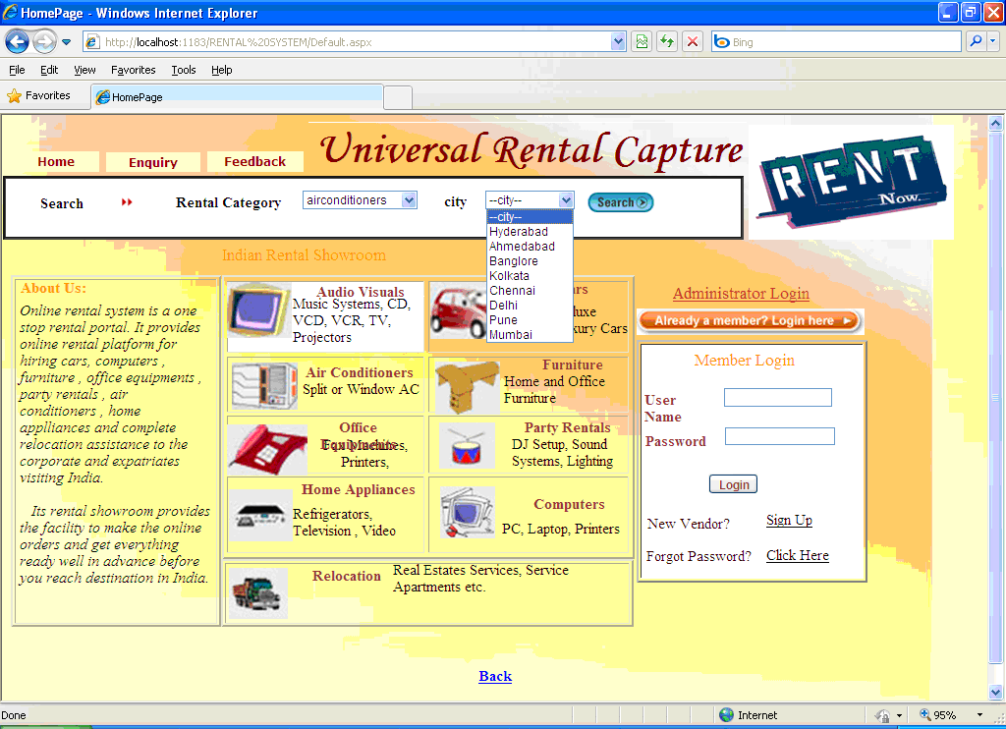
Search Rental Category By User

Slide 21
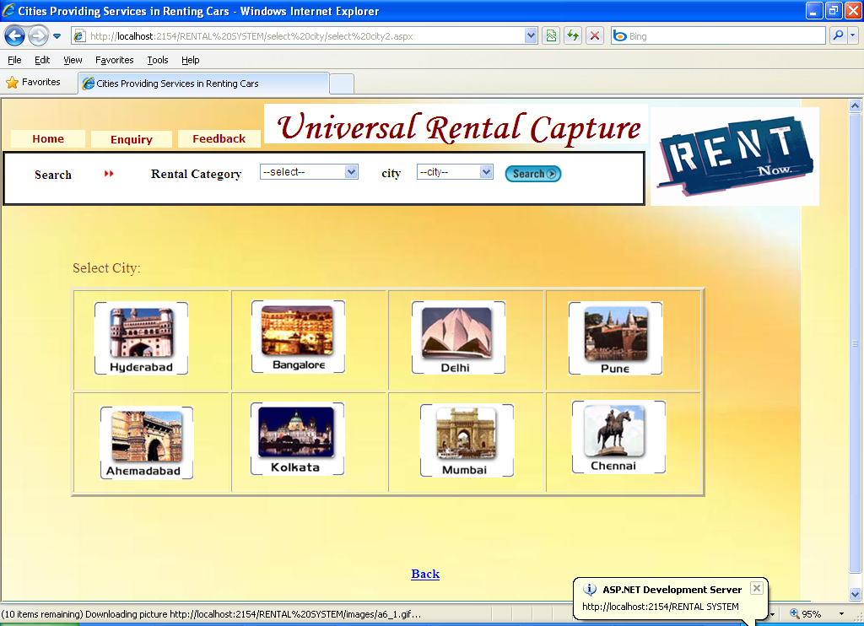
Select City from the User Interface

Slide 22
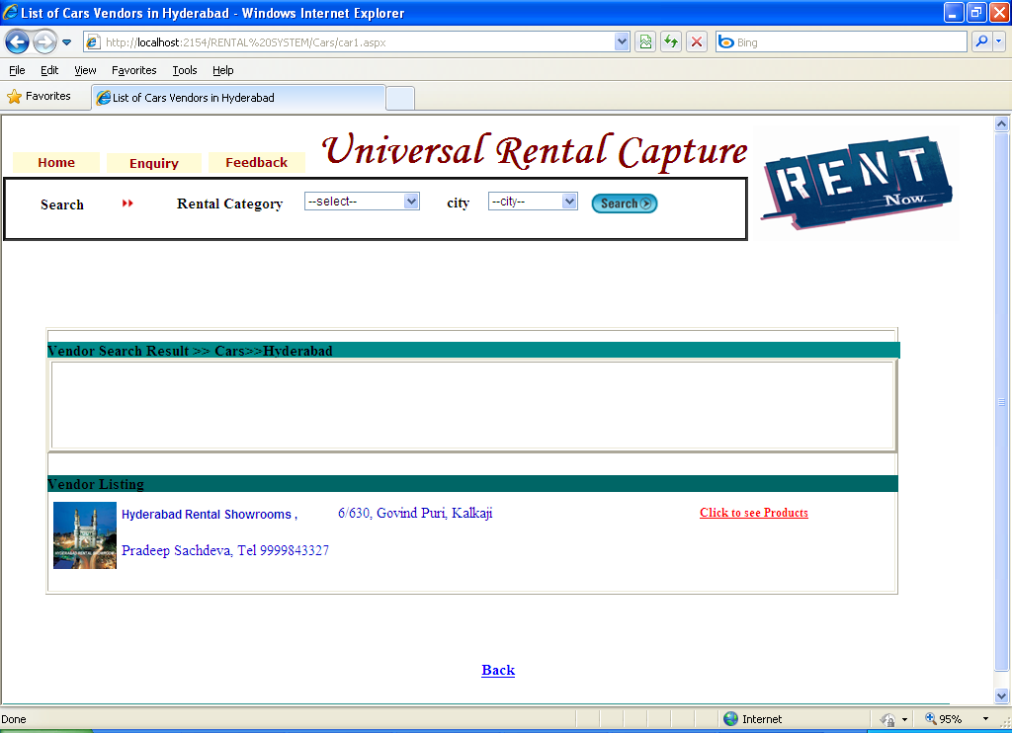
Get the Products from Selected city

Slide 23
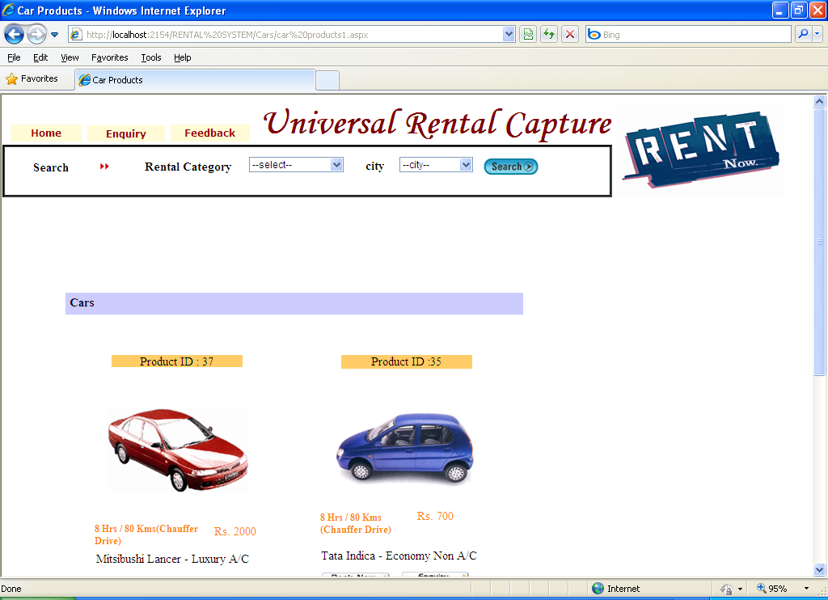
Products Displayed to Customer

Slide 24
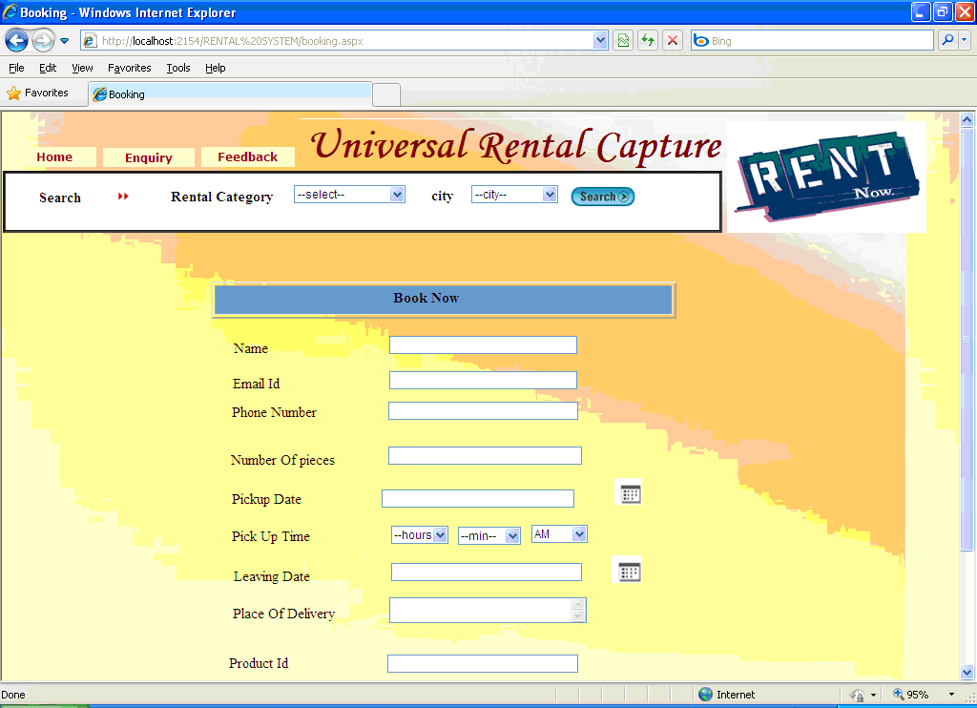
Book the Products from User

Slide 25
Verify Bookings and Intimate to Vendor
    The Administrator after Login to the site he verifies for recent bookings from customers. Then he needs to forward all bookings details to the Vendors.

Slide 26
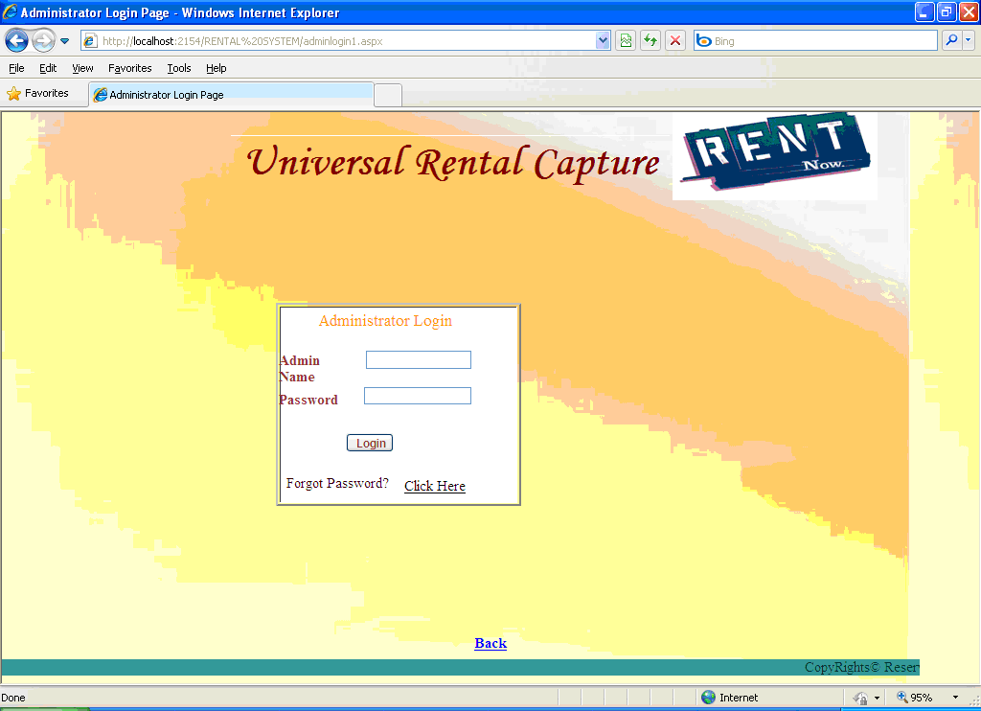
Administrator Login

Slide 27
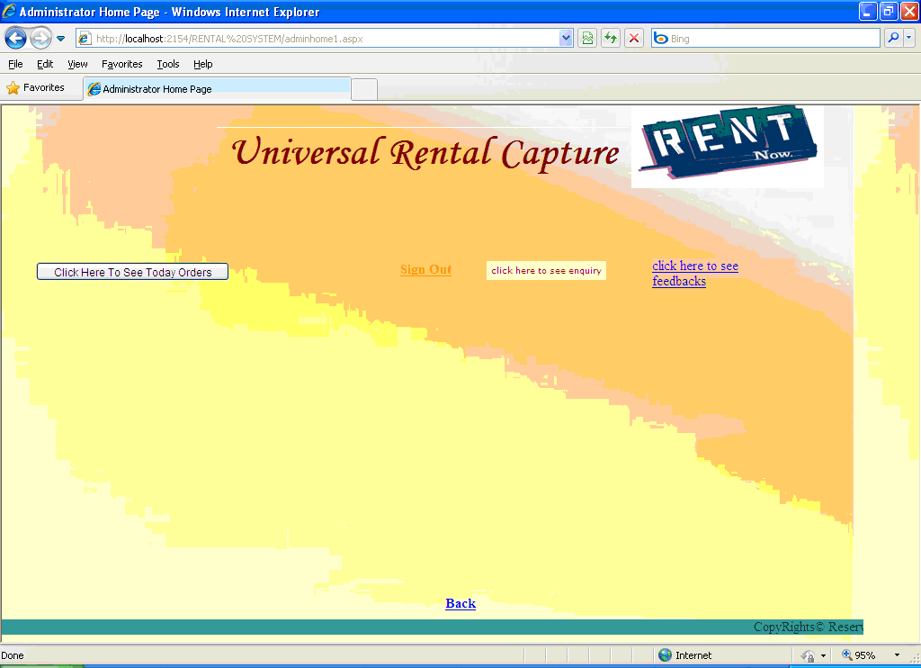
Admin Home Page

Slide 28
Authentication:
Authentication is nothing but providing security to the system. Here every must enter into the system throw login page.
A user must provide his credential like user Id and password for log into the system. For that the system maintains data for all users. Whenever a user enters his user id and password, it checks in the database for user existence. If the user is exists he can be treated as a valid user.

Slide 29
Data base maintenance
The data provided by the Vendors such as product details, personal details, etc and data provided by the customer such as feedback and booking details will be maintained in a data base by the website administrator.
Data in database is maintained securely.

Slide 30
Database Design
Products Table:
Sno | Columnname | Datatype | Constraint | reference
1 | Vendor Name | Varchar(50) | Primary key
2 | Product Type | Varchar(50) | Not NULL
3 | Avail City | Varchar(50) | Not NULL
4 | Product Name | Varchar(50) | Not NULL
5 | Start Date | Date Time | Not NULL
6 | End Date | Date Time | Not NULL
7 | Rent | Varchar(50) | Not NULL
8 | Status | Varchar(50) | Not NULL
9 | Description | Varchar(50) | Yes
10 | Picture | Image | Not NULL
11 | Product id | Int | Foreign key | Products

Slide 31
Bookings Table
Sno | Columnname | Datatype | Constraints | Reference
1 | Name | Varchar(50) | Primary key
2 | Requirement | Varchar(50) | Not NULL
3 | Date | Date Time | Not NULL
4 | Source Address | Varchar(MAX) | Not NULL
5 | Destinationaddress | Varchar(MAX) | Not NULL
6 | Phone Number | Varchar(50) | Not NULL
7 | Email id | Varchar(50) | Not NULL

Slide 32
Vendor Details Table
Sno | Columnname | Datatype | Constraints | Reference
1 | First name | Varchar(50) | Not NULL
2 | Last name | Varchar(50) | Not NULL
3 | User Name | Varchar(50) | Primary key
4 | Password | Varchar(50) | Not NULL
5 | Address | Varchar(MAX) | Not NULL
6 | City | Varchar(50) | Not NULL
7 | State | Varchar(50) | Not NULL
8 | Pin Code | Varchar(50) | Not NULL
9 | Credit Card no | Varchar(50) | Not NULL
10 | Mobile Number | Varchar(50) | Not NULL
11 | TelephoneNumber | Varchar(50) | Yes
12 | Email id | Varchar(50) | Not NULL
13 | Alternate Email id | Varchar(50) | Not NULL
14 | Birth Date | Date Time | Not NULL
15 | Security Question | Varchar(MAX) | Not NULL
16 | Answer | Varchar(MAX) | Not NULL

Slide 33
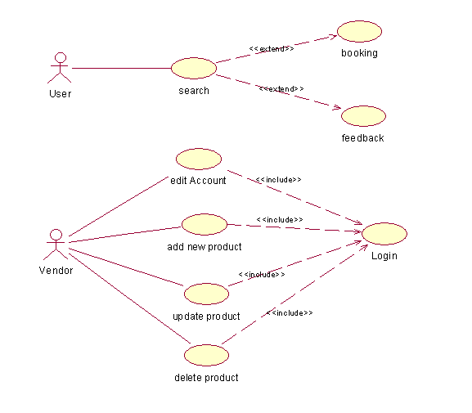
Use case Diagram in our system:
USER
VENDOR

Slide 34
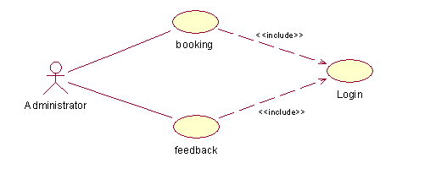
ADMINISTRATOR

Slide 35
Conclusion
The main purpose of RENTAL SYSTEM is Vendors to advertise their available products and also to provide available products booking for the customers. Here in the system we are providing a great flexibility for the vendor to make changes to products and as well update or delete their personal account in our web site. We are also providing great flexibility for the users that they need not register in to our website; they just access the site search for products and place bookings about the products.

Slide 36

THANK YOU

